Slide 1
Innovative test solution
Provider
- Probe pin Datasheet -

Slide 2
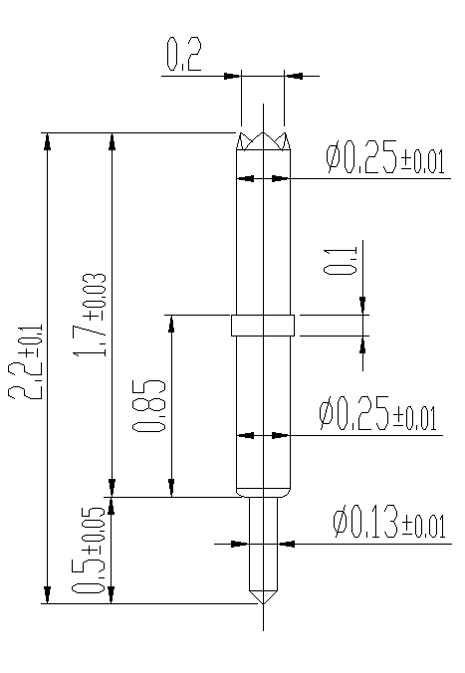
※ General POGO pin – 2.2mm / 0.35P
IVB-SAR-220-025-A079-00
Pitch | 0.35mm
Total Length | 3.3mm
Use Length | 2.9mm
Use Stroke | 0.4mm
Recommended Top Plunger Stroke | 0.3mm
Recommended Bottom Plunger Stroke (Pre-load) | 0.1mm
Max Stroke | 0.5mm
Spring Force at Use Stroke | 18gf at 0.4mm Stroke
Operating Temperature | -40 to 120°C
DC Resistance | Avg. 40.0mΩ at 0.4mm stroke
Current Rating | 1.0A (Continuous)
Self Inductance | 0.89 nH
Bandwidth @ -1dB | 21.3 GHz
Top Plunger | BeCu / Au over Ni
Bottom Plunger | BeCu / Au over Ni
Barrel | PBT / Au over Ni
Spring | Music wire / Au
Insertion Life | 100,000 cycles at 0.4mm Stroke

Slide 3
Thank you.

